Slide 1
Computer Systems & Networks Assignment 2
Project Flowchart Presentation
Naoise O’Sullivan - 20091403
Please run the slideshow for a demonstration of logical flow paths for the project

Slide 2
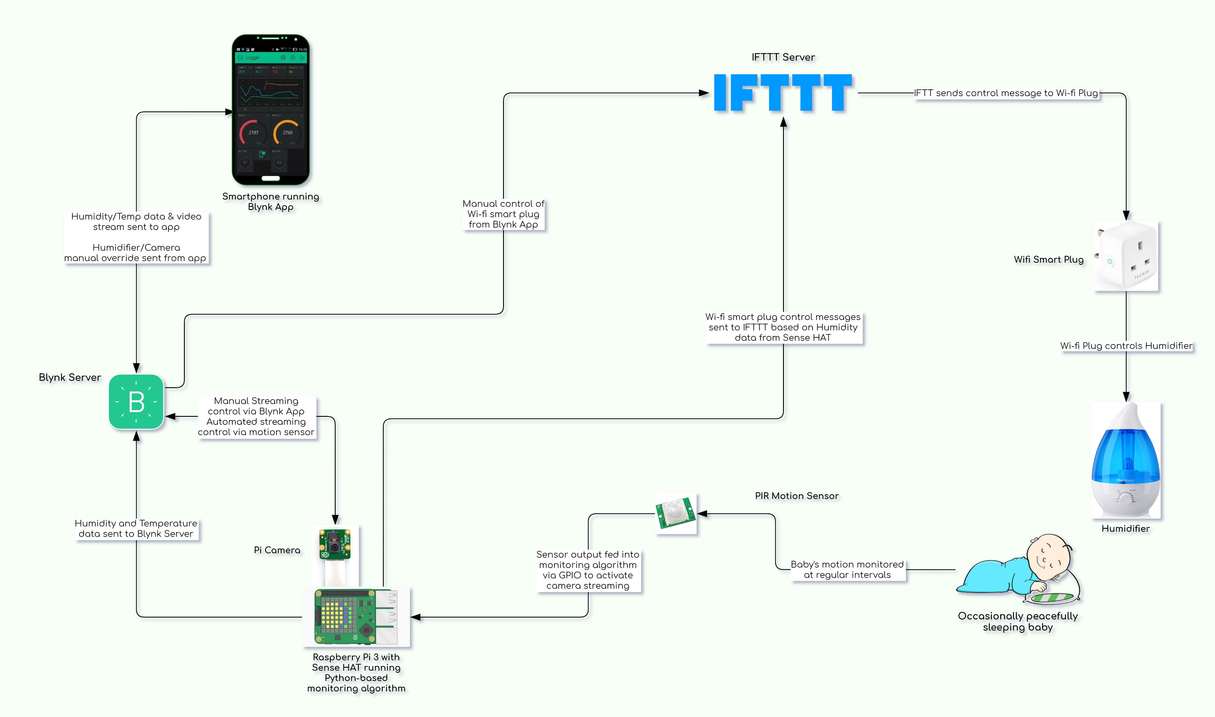
Baby’s motion triggers video stream
Sense HAT Humidity Sensor controls Humidifier
Manual Video Stream activation
Manual control of Humidifier from Blynk App
Temp & Humidity Data Sent to Blynk App

